Slide 1
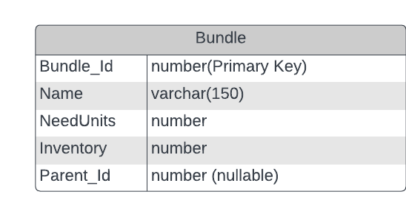
Database schema for Bundle Problem
Bundle_Id | Name | NeedUnits | Inventory | Parent_Id
1 | Bike | 1 | 0 | null
2 | Seat | 1 | 50 | 1
3 | Padals | 2 | 60 | 1
4 | Wheels | 2 | 0 | 1
5 | Frame | 1 | 60 | 4
6 | Tube | 1 | 35 | 4
Create Table Query:
CREATE TABLE Bundle (
Bundle_id INT PRIMARY KEY,
parent_id INT NULL REFERENCES Bundle (node_id),
Name varchar(150),
NeededUnits INT,
Inventory INT,
);

